Slide 1
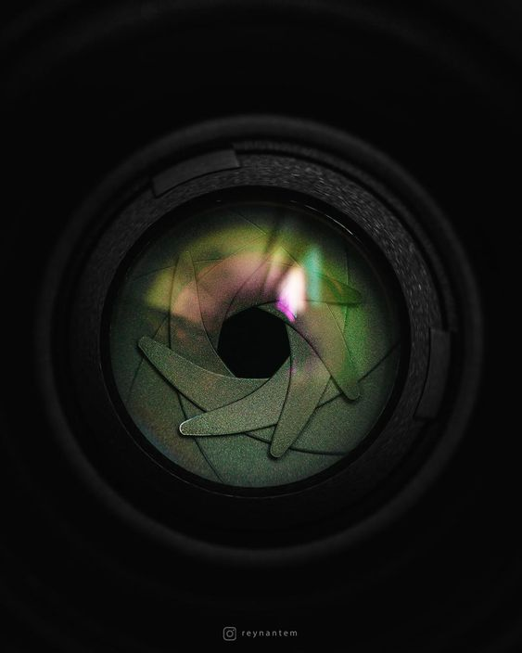
LENS ON WILD
- Pallavi
4PA21CS098
3rd Year CSE
PACE , MANGALORE

Slide 2
Introduction
Embarking on the adventure of wildlife photography is both exciting and a bit tricky.
Many beginners face challenges in capturing the beauty of the wild.
This project aims to help aspiring photographers, especially those who are just starting and may not know much about wildlife photography.
Additionally, also supporting the “Wild Animals Donation Fund”. Your contribution helps protect and preserve the habitats of these incredible creatures

Slide 3
Our Community
Highlight different photography styles within the association, ranging from wildlife portraits and action shots to macro photography and landscape compositions.
Illustrate the versatility and creativity of the photographers contributing to the association's gallery.
Encourage viewers to explore more by visiting the association's website or gallery section.

Slide 4
Experience section:
This content structure aims to provide a comprehensive and visually engaging overview of the association's journey, milestones, and the collective impact it has made over time.
Through compelling visuals and narratives, we invite you to delve into the heart of our collective journey, celebrating the passion, dedication, and collaborative spirit that have fueled our community's growth.
Adjust the details based on the specific experiences and achievements of our wildlife photography association, and join us as we continue to shape a future where conservation and creativity intersect seamlessly.

Slide 5


Donation:
This content structure aims to inspire and inform potential donors about the wildlife sanctuary's mission, the impact of their contributions, and the various ways they can support ongoing conservation efforts.
Adjust the details to align with the specific initiatives and goals of the wildlife sanctuary you are promoting.

Slide 6
Top Locations:
Wildlife locations often have official websites that serve as valuable resources for wildlife photographers. These websites typically provide essential information, updates, and guidelines that can help photographers plan and execute successful trips.
It helps to:
Trail and Safari Information
Weather and Climate Details
Conservation Initiatives
Contact and Emergency Information

Slide 7
Advantages:
Connecting with the Photography Community
Showcasing Photography Portfolio
Showcasing Experience and Behind-the-Scenes content
Client Interaction and Inquiries
Promoting Conservation and Awareness
Social Media Integration

Slide 8



Software Requirements:

Slide 9
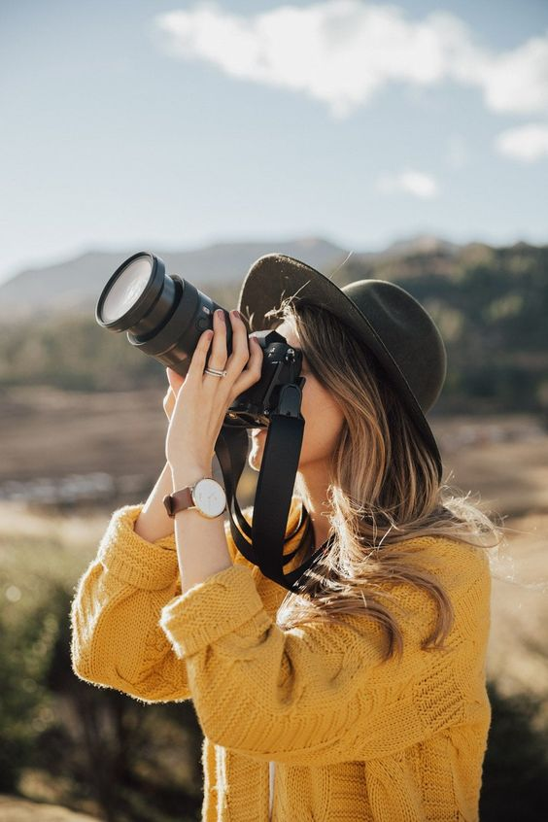
SHOOT ANIMALS WITH CAMERA NOT WITH GUN : )
#DOSUPPORT
#LENSONWILD
#SAVEWILDANIMALS

Slide 10

THANK YOU

